Slide 1
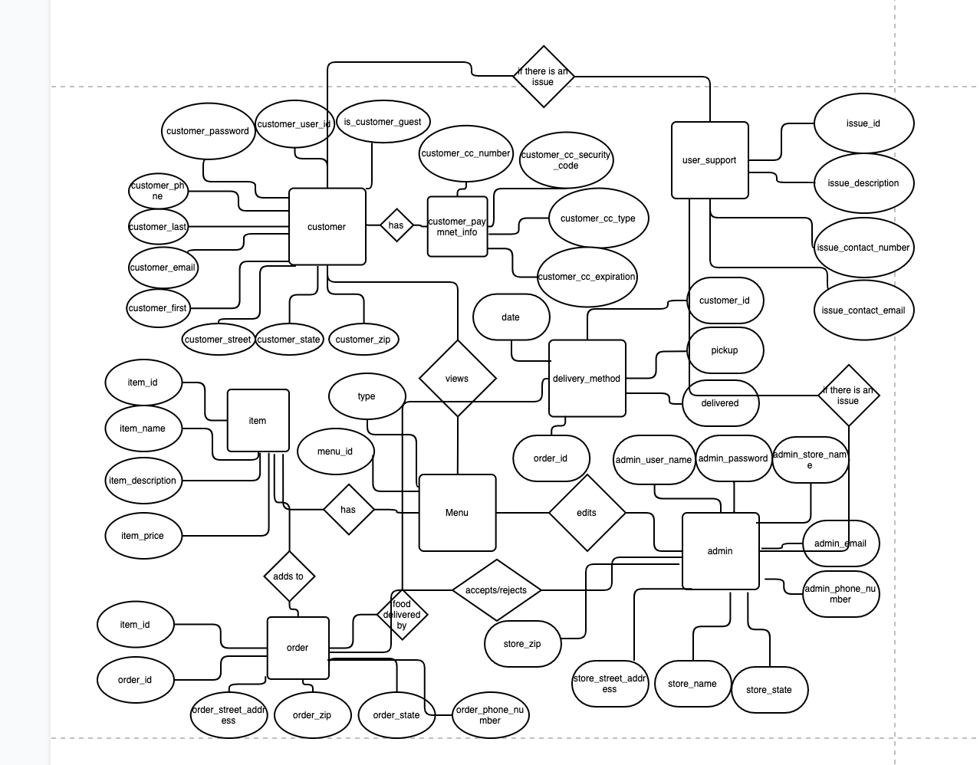
Team 2: InWood Bagels
Conceptual ER Diagrams

Slide 2
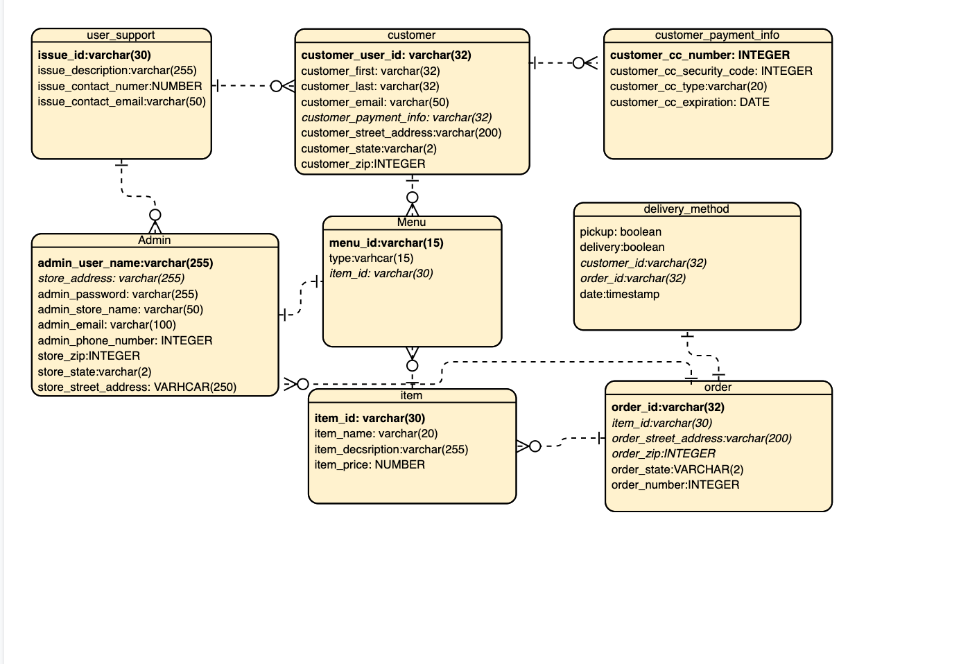
Team 2: InWood Bagels
Logical ER Diagrams
Bolded attributes = Primary Key
Italicized attributes = Foreign Key

